Slide 1
DENTAL MANAGEMENT SYSTEM
DONE BY :
T.GOWTHAM

Slide 2
INSTAATION PROCEDURE
Dental Management System :-
Pre-Requisites :-
1. You have to have the following softwares for the successful running of this software; which are
I) Python (Only for the First time), it is downloadable from 'www.python.org'.
II) MySQL (Only for the First time), it is downloadable from 'www.mysql.org'.
Installation :-
1. There will be two folders namely 'Python Files' and 'EXE files'.
2. The folder 'Python Files' will contain the source code of the software in python language. If you are running the software by the 3rd step mentioned below you have to pre install the following modules :-
I) mysql.connector
II) matplotlib.
3. Open the files in any python editors and run it to start and work on the software.
4. The folder 'EXE files' will contain two files namely 'main.exe' and 'Tables_in_mysql.exe'.
5. First run the 'Tables_in_mysql.exe' to create the tables in MySQL.
Then run the file 'main.exe' to start and work on the software.
CAUTION :-
If you are running the software through running the python files or by running the .exe files ; first run the file named 'Tables_in_mysql'.
The .exe file will take a lot of time; so be PATIENT.

Slide 3
INSTALATION PROCEDURE Dental Management System :- Pre-Requisites :- 1. You have to have the following softwares for the successful running of this software; which are I) Python (Only for the First time), it is downloadable from 'www.python.org'. II) MySQL (Only for the First time), it is downloadable from 'www.mysql.org'. Installation :- 1. There will be two folders namely 'Python Files' and 'EXE files'. 2. The folder 'Python Files' will contain the source code of the software in python language. If you are running the software by the 3rd step mentioned below you have to pre install the following modules :- I) mysql.connector II) matplotlib. 3. Open the files in any python editors and run it to start and work on the software. 4. The folder 'EXE files' will contain two files namely 'main.exe' and 'Tables_in_mysql.exe'. 5. First run the 'Tables_in_mysql.exe' to create the tables in MySQL. Then run the file 'main.exe' to start and work on the software. CAUTION :- If you are running the software through running the python files or by running the .exe files ; first run the file named 'Tables_in_mysql'. The .exe file will take a lot of time; so be PATIENT.

Slide 4
INTRODUCTION
The project dental management system is developed with a view of assist dental hospital in their functioning. This project is aimed at providing easy access to the administration about their patient records and their employee records.

Slide 5
SOURCE CODE
if conn.is_connected:
print(" Dental Management System ")
print("1. Login")
print("2. Exit")
print()
option=int(input("Enter your choise : "))
if option==1:
print()
user=input('User Name : ')
user=user.upper()
cur.execute("select * from accounts where User_Name like '" + user + "'")
datas=cur.fetchall()
for i in datas:
value_1=i[0]
value_2=i[1]
if user==value_1:
password=input('Password : ')
password=password.upper()
if password==value_2:
print()
print('Login succefull')

Slide 6
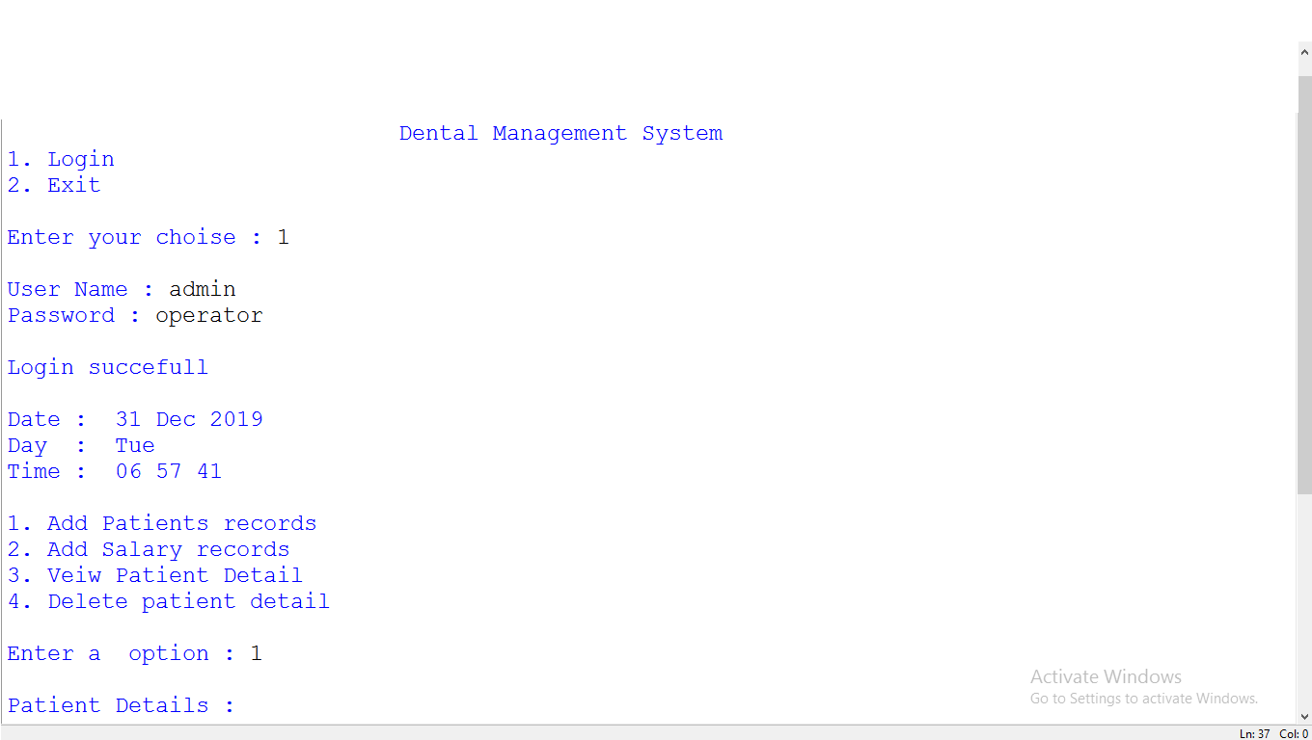
OUTPUT

